Slide 1
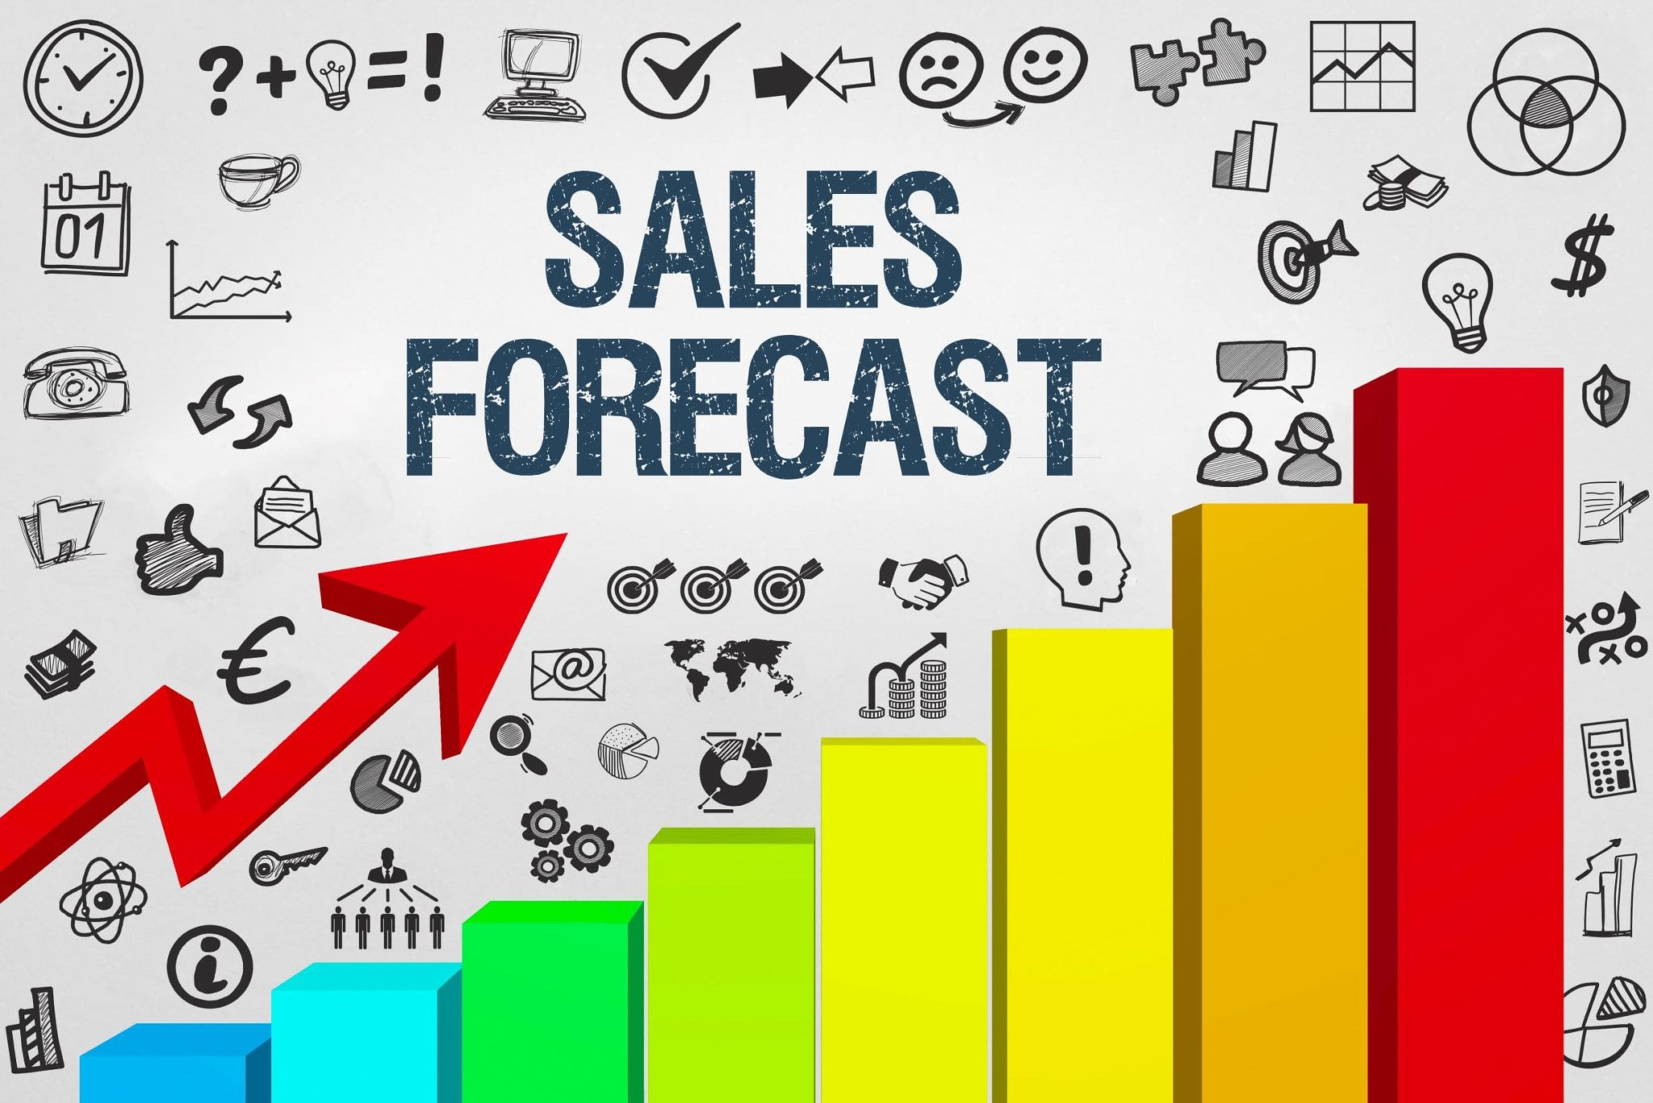
Sales Forecasting on Sales Data Set
IDMP (DS 5110)
Submitted By:
Ayman Mushtaq Ahmad
Amisha Tiwari
Ronhit Neema

Slide 2
Table of Contents
Problem Statement
Our Idea
Dataset Overview and EDA
Data Preprocessing and Model training
Visualization and Analysis
Project Demonstration
Conclusion
Future Scope

Slide 3
Problem Statement

Slide 4

Problem Statement
Challenge: Retailers need accurate sales forecasting in retail to avoid poor inventory management.
Objective: Explore various regression models and select the best Machine learning model to predict Sales using features in the dataset.
Impact: Accurate forecasts enable better inventory planning and improved decision making for business.

Slide 5
Our Idea

Slide 6
Our Idea
Solution: Use historical sales data to build a regression model that accurately predicts future sales and provides insights.
Approach: Preprocess the dataset, conduct EDA, select relevant features, and employ regression algorithms for model development.
Evaluate model performance, optimize hyperparameters, and provide actionable insights.
Innovation: Deliver a user friendly WebApp with intuitive visualizations and model comparisons.

Slide 7
Dataset Overview and EDA

Slide 8
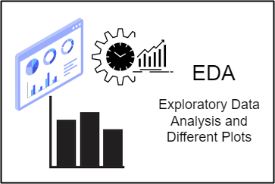
Dataset Overview and EDA
Dataset Features: 8523 rows , 12 columns with features like Item, Outlet, Visibility and Sales.
EDA identified missing Values, Outliers and Data Inconsistencies.

Slide 9
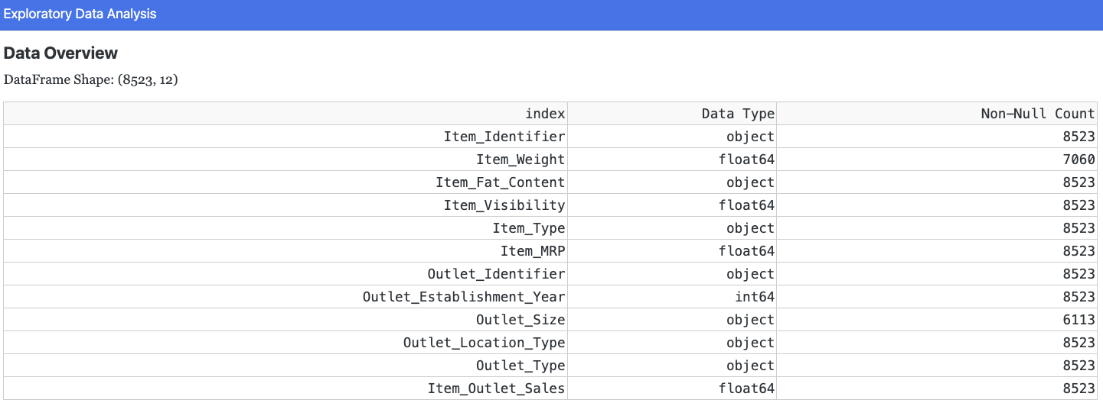
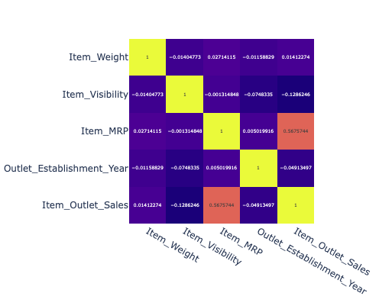
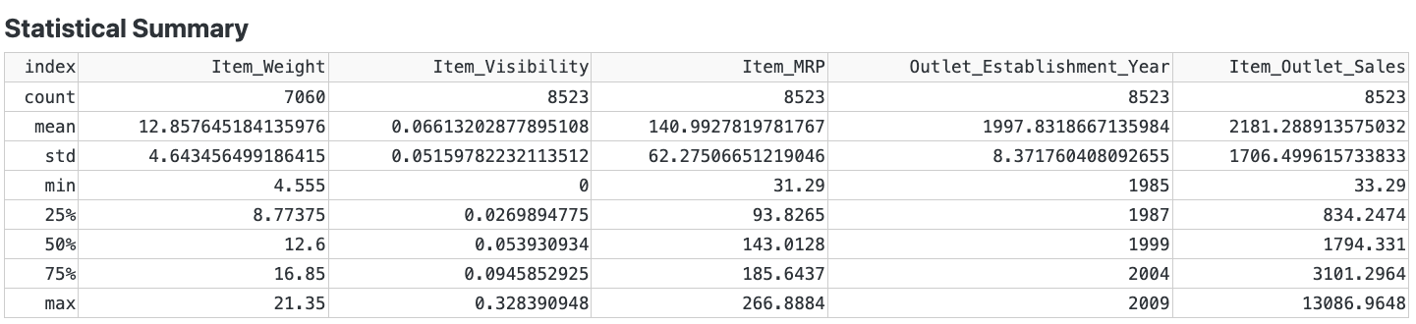
Dataset Overview And EDA
Summary:
Shape: 8523 rows, 12 columns.
Target Variable: Item_Outlet_Sales

Slide 10
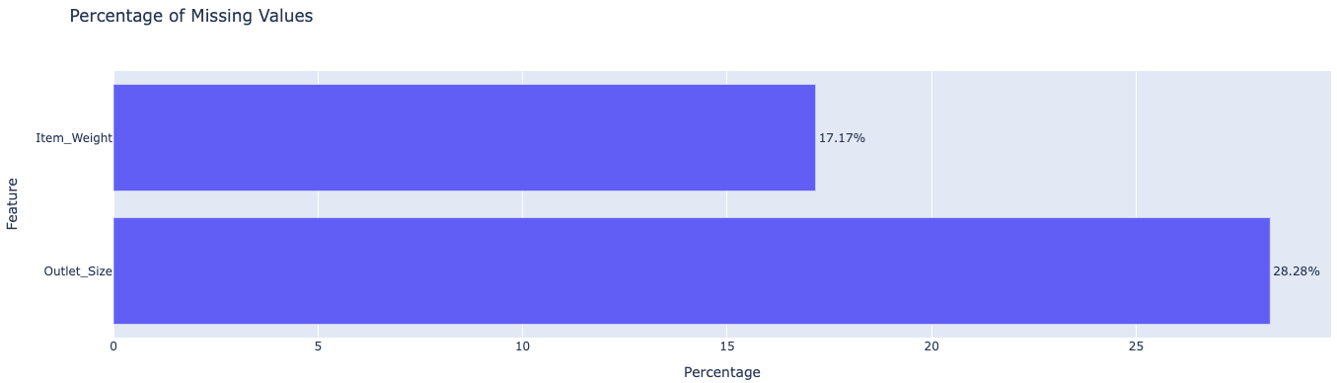
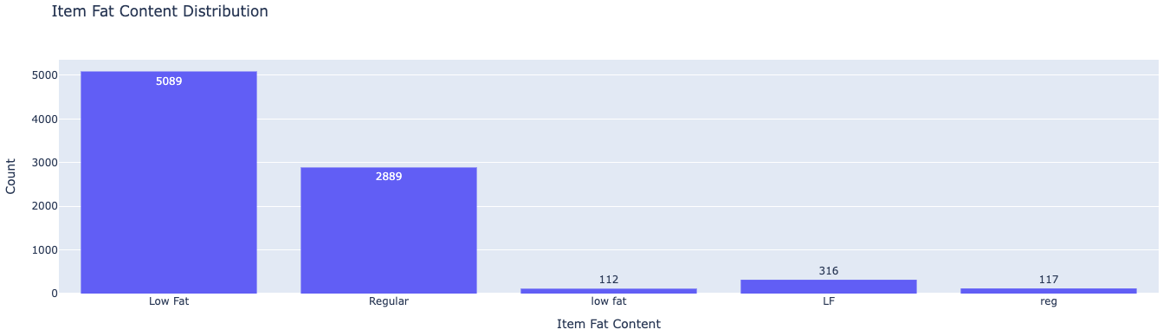
Dataset Overview And EDA
Significant missing values in Item_Weight (~17%) and Outlet_Size (~28%)
Standardization needed in Item Fat Content.

Slide 11
Data Pre-Processing and Model Training

Slide 12

Data Pre-Processing And Model Training
Methodology:

Slide 13
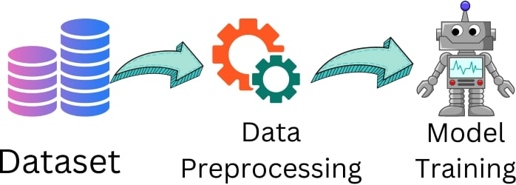
Data Pre-Processing And Model Training
Preprocessing: Imputation, Outlier treatment, Feature engineering.
Regression Models: Linear, Ridge, Lasso, Random Forest, XGBoost, CatBoost, LGBM.
RandomizedSearchCV used for hyperparameter tuning.

Slide 14
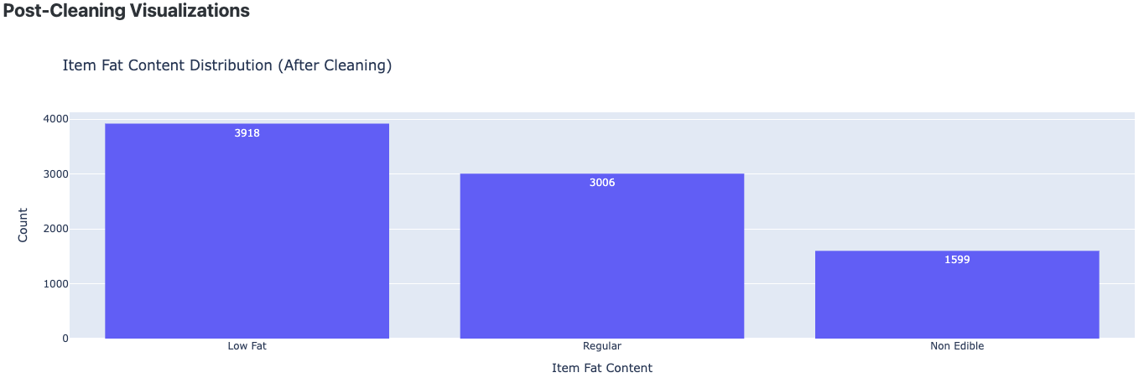
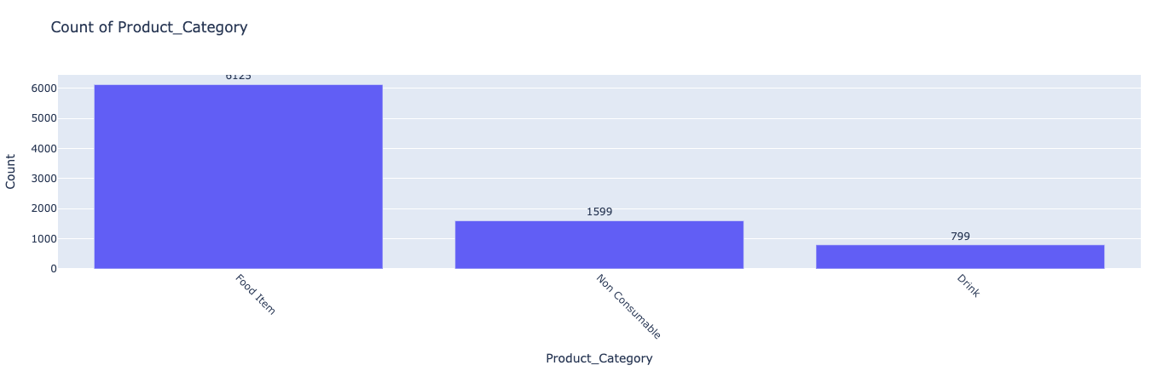
Data Pre-Processing And Model Training
Label Encoding for categorical features(LabelEncoder).
Standardization for numerical features(StandardScaler).
Splitting Data into training and testing sets(train_test_split).

Slide 15
Visualization and Analysis

Slide 16
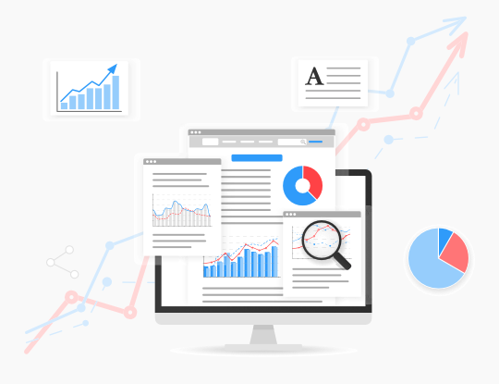
Visualization and Analysis
Model Comparison Summary
Interactive Dash Visualizations for insights.
Feature Importance
Key Plots: Correlation Heatmaps, residual distribution, Residual vs fitted plots, SHAP

Slide 17
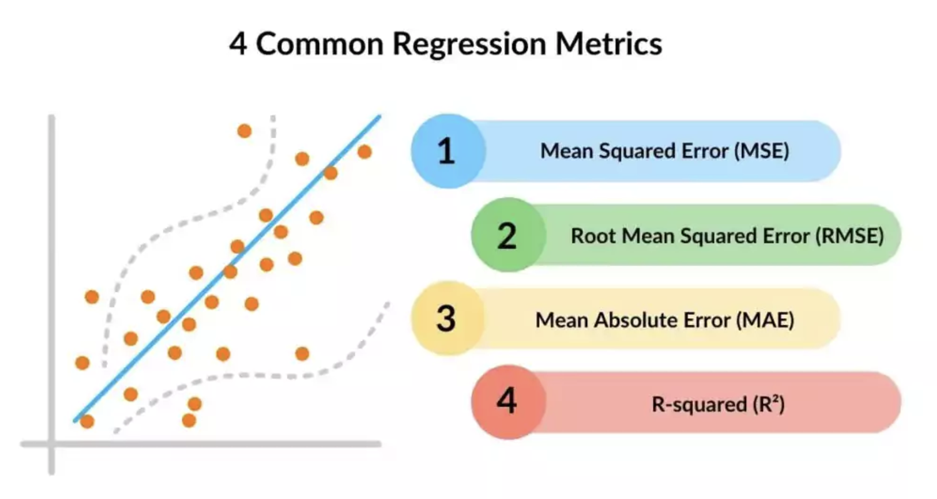
Visualization and Analysis
Model Comparison Metrics

Slide 18
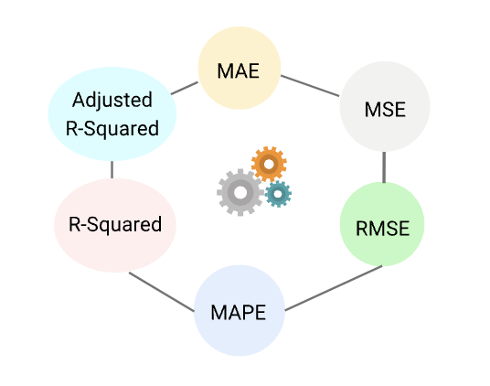
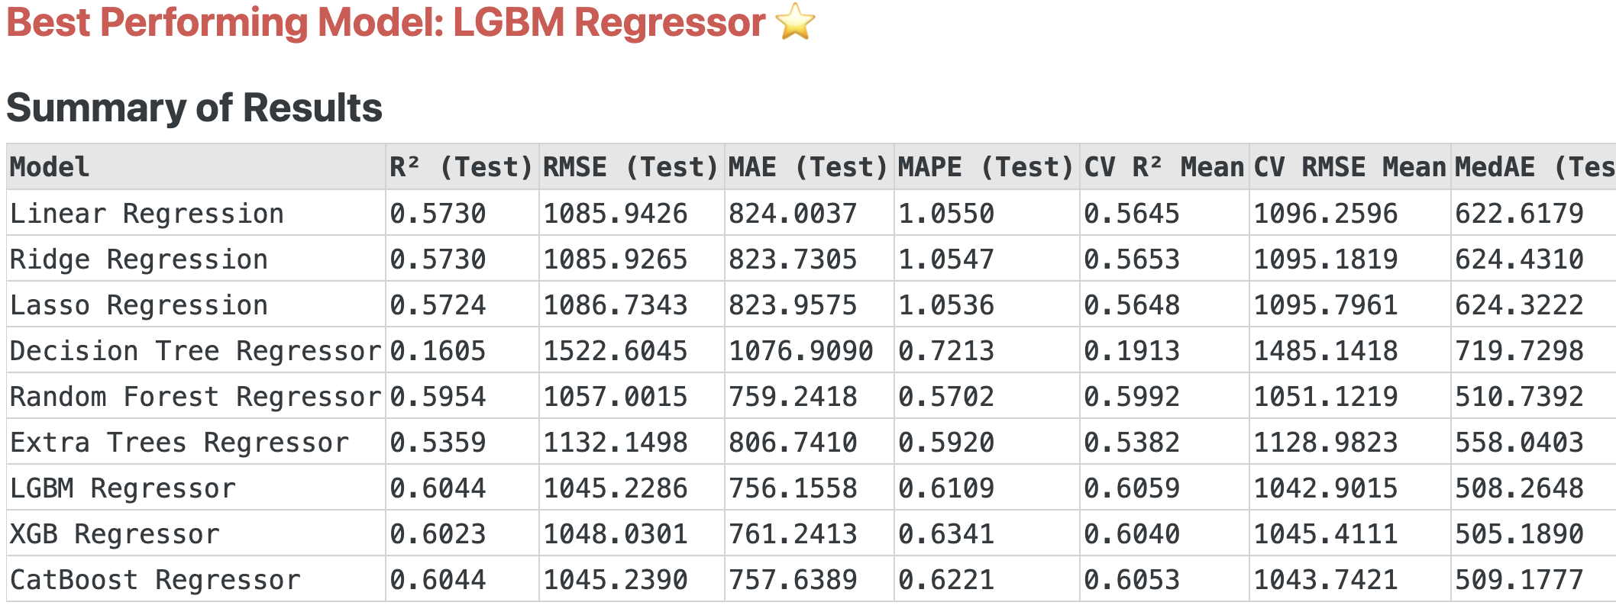
Visualization and Analysis
Model Comparison

Slide 19
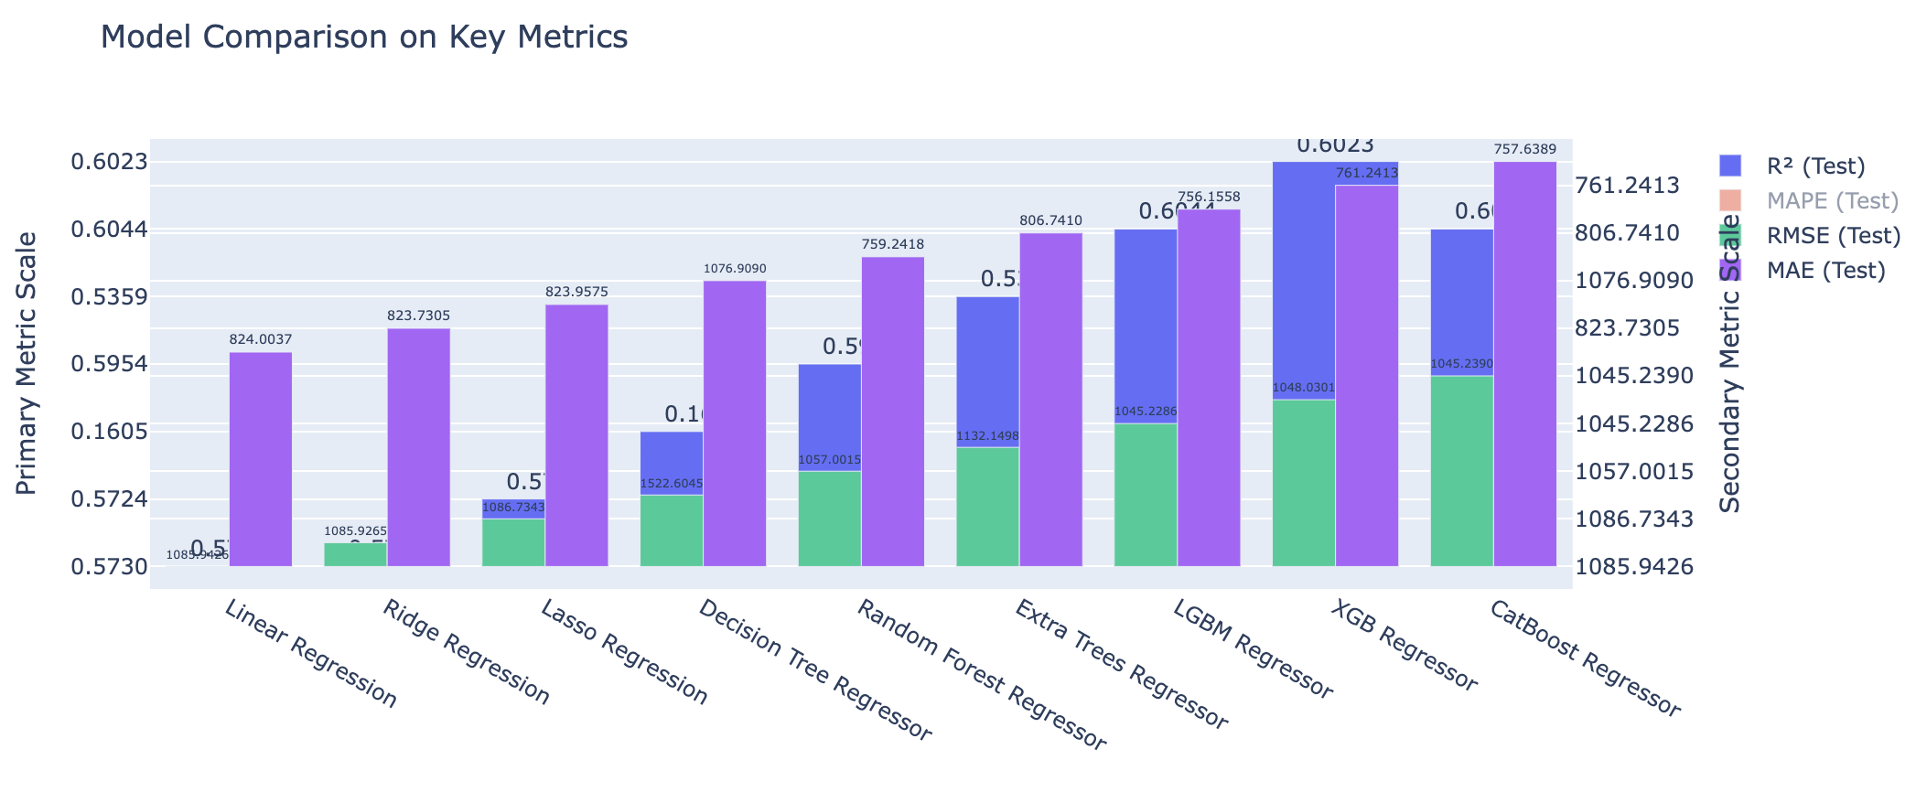
Visualization and Analysis
Interactive Dash Visualizations for Model Comparison on Key Metrics

Slide 20
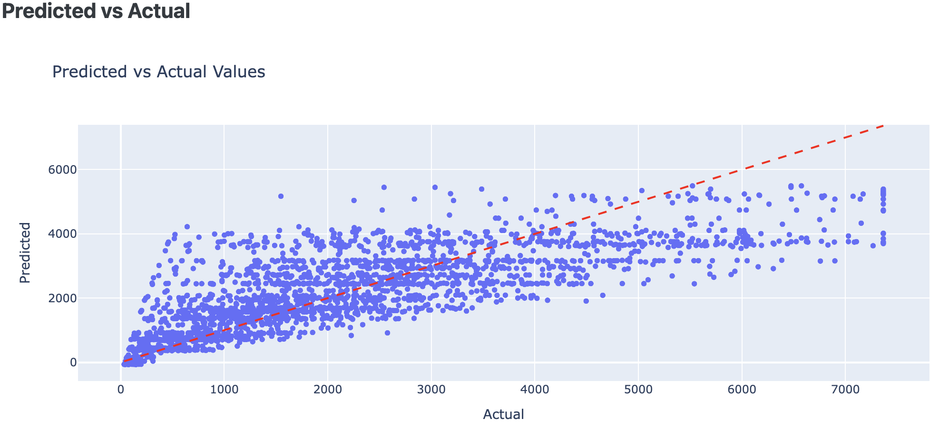
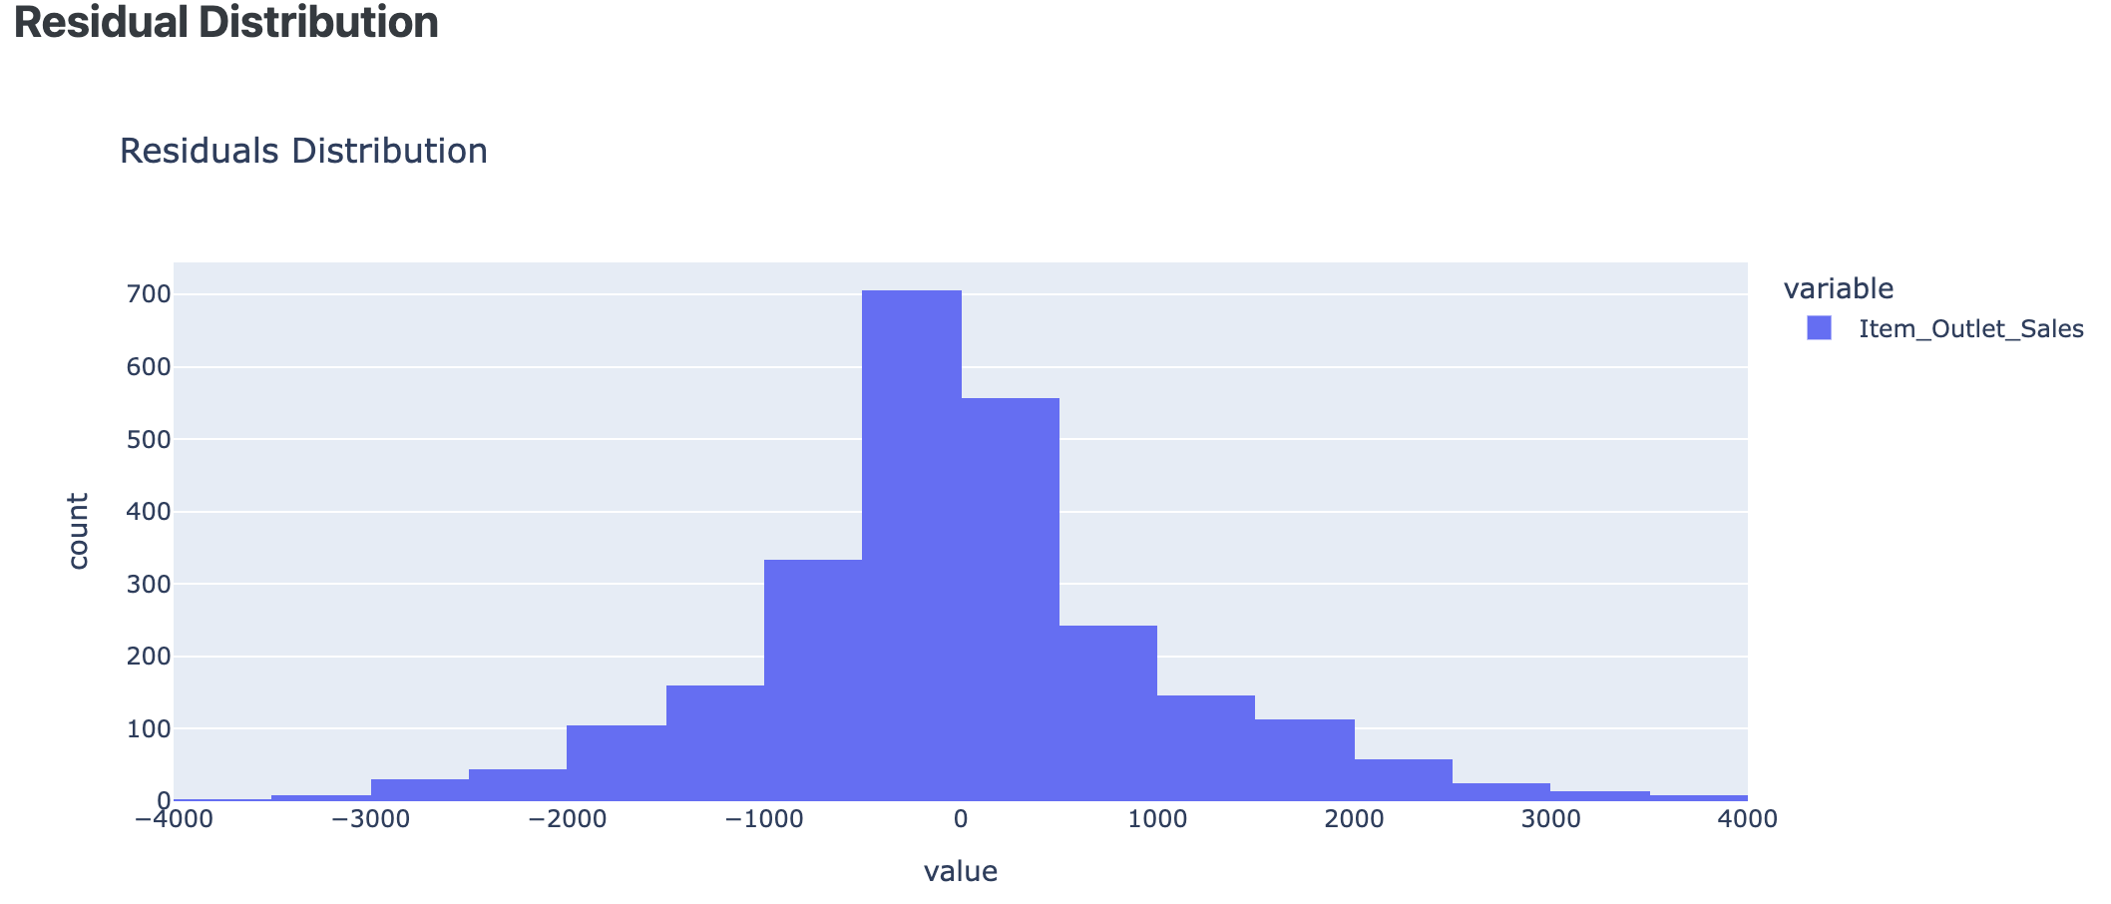
Visualization and Analysis
Interactive Dash Visualizations for every model

Slide 21



Project Application
WebApp with Flask and Dash
Real-Time, dynamic updates with Modular design
User friendly with Upload, EDA, Modeling and Visualization features for Users.

Slide 22
Project Demo

Slide 23
Conclusion

Slide 24

Conclusion
Business Impact: Scalable and accurate sales forecasting solution.
Tree based models excel in non-linear relationships.
Key Insight: Item MRP, Outlet Type, Item Visibility are strongest predictors of sales.

Slide 25
Future Scope

Slide 26

Future Scope
Application: Extend the application to handle larger datasets with time series features.
Feature Engineering: Incorporate seasonal trends and complete ARIMA for time series features.
Model Improvement: Fine-Tune hyperparameters for Regressor models.

Slide 27


